Slide 1

Python & Engineering Foundations for AI Systems

Slide 2

Introduction to Python
Introduction to Python
A quick introduction to Python syntax, variable assignment, and numbers
Functions and Getting Help
Calling functions and defining our own, and using Python's builtin documentation
Booleans and Conditionals
Using booleans for branching logic
Lists
Lists and the things you can do with them. Includes indexing, slicing and mutating
Loops and List Comprehensions
For and while loops, and a much-loved Python feature: list comprehensions
Strings and Dictionaries
Working with strings and dictionaries, two fundamental Python data types
Working with External Libraries
Imports, operator overloading, and survival tips for venturing into the world of external libraries
Notes:
https://www.kaggle.com/learn/python

Slide 3
Introduction to Pandas
Creating, Reading and Writing
Indexing, Selecting & Assigning
Summary Functions and Maps
Extract insights from your data.
Grouping and Sorting
Scale up your level of insight. The more complex the dataset, the more this matters
Data Types and Missing Values
Deal with the most common progress-blocking problems
Renaming and Combining
Data comes in from many sources. Help it all make sense together
Notes:
https://www.kaggle.com/learn/pandas

Slide 4
Data Visualization
Seaborn
Your first introduction to coding for data visualization
Line Charts
Visualize trends over time
Bar Charts and Heatmaps
Use color or length to compare categories in a dataset
Scatter Plots
Leverage the coordinate plane to explore relationships between variables
Distributions
Create histograms and density plots
Choosing Plot Types and Custom Styles
Customize your charts and make them look snazzy
Notes:
https://www.kaggle.com/learn/data-visualization

Slide 5
Introduction to Machine Learning
Models
The first step if you're new to machine learning.
Basic Data Exploration
Load and understand your data.
Your First Machine Learning Model
Building your first model.
Model Validation
Measure the performance of your model, so you can test and compare alternatives.
Underfitting and Overfitting
Fine-tune your model for better performance.
Random Forests
Using a more sophisticated machine learning algorithm.
Notes:
https://www.kaggle.com/learn/intro-to-machine-learning

Slide 6
Intermediate Machine Learning
Introduction
Missing Values
Missing values happen. Be prepared for this common challenge in real datasets.
Categorical Variables
There's a lot of non-numeric data out there. Here's how to use it for machine learning.
Pipelines
A critical skill for deploying (and even testing) complex models with pre-processing.
Cross-Validation
A better way to test your models.
XGBoost
The most accurate modeling technique for structured data.
Data Leakage
Find and fix this problem that ruins your model in subtle ways.

Slide 7
Feature Engineering
What Is Feature Engineering
Mutual Information
Locate features with the most potential.
Creating Features
Transform features with Pandas to suit your model.
Clustering With K-Means
Untangle complex spatial relationships with cluster labels.
Principal Component Analysis
Discover new features by analyzing variation.
Target Encoding
Boost any categorical feature with this powerful technique.
Notes:
https://www.kaggle.com/learn/feature-engineering

Slide 8
Computer Vision
The Convolutional Classifier
Create your computer vision model with Keras.
Convolution and ReLU
Discover how convnets create features with convolutional layers.
Maximum Pooling
Learn more about feature extraction with maximum pooling.
The Sliding Window
Explore two important parameters: stride and padding.
Custom Convnets
Design your own convnet.
Data Augmentation
Boost performance by creating extra training data.
Notes:
https://www.kaggle.com/learn/computer-vision

Slide 9
Natural Language Processing
Module 1: Word Embeddings:
Leave rigid, traditional methods behind. Learn to map, visualize, and mathematically measure the geometric “closeness” of words as dense mathematical vectors using Cosine Similarity and PCA.
Module 2: Preparing Text Data:
Process raw text data, handle variable sentence lengths with zero-padding, and format data into efficient matrices for neural networks.
Module 3: Recurrent Neural Networks (RNNs):
Give neural networks an internal “memory” loop. Using the Keras Functional API, we’ll build Simple RNNs that process text sequentially instead of all at once.
Module 4: Long Short-Term Memory (LSTM):
Overcome the “Vanishing Gradient Problem” of Simple RNNs. Crack open the complex inner mechanics of LSTMs and learn how to use Forget, Input, and Output gates to maintain a continuous conveyor belt of memory.
Module 5: Bidirectional Long Short-Term Memory (Bidirectional LSTM):
Synthesize context from both the past and the future simultaneously. Learn how true meaning often depends on words that appear later in a sentence.
Notes:
https://www.kaggle.com/learn-guide/intermediate-nlp

Slide 10
Model Evaluation
Module 1 - Introduction to Model Evaluation
Build a mental framework for what constitutes a reliable model. You will review the machine learning workflow and explore the fundamental tension between learning the data and generalizing to new data.
Module 2 - Understanding Regression Errors
Before aggregating errors into formal metrics, examine the raw mistakes your model makes. You will learn to define and interpret the foundational concepts of regression error.
Module 3 - Regression Performance Metrics
Evaluate your continuous predictions and learn how to penalize models that are overly complex to prevent overfitting.
Module 4 - Understanding Classification Errors
Categorize your model's prediction mistakes to understand their real-world impact. You will learn how to read a confusion matrix and distinguish between different types of failure.
Module 5 - Classification Performance Metrics
Discover why simple accuracy is often misleading and learn the specialized metrics needed for imbalanced datasets and nuanced decision-making.
Module 6 - Cross Validation
Move beyond a single train-test split to ensure your model's evaluation metrics are robust, reliable, and truly representative of its ability to generalize.
Notes:
https://www.kaggle.com/learn-guide/model-evaluation

Slide 11

AsyncAPI documentation and hands on studio workflow

Slide 12
Modeling real time event contracts with AsyncAPI documents
Choosing channel patterns for event driven design
Model channel naming, message payload structure, and operation semantics so producers and consumers remain compatible across environments.
Bringing theory to a production ready spec
Translate the tutorial guidance into a clean AsyncAPI document that supports governance, versioning, and safer client integrations.
AsyncAPI core concepts and event contracts
Learn how AsyncAPI defines publish/subscribe contracts, transports, and message schemas for real-time systems using the official tutorial example.

Slide 13
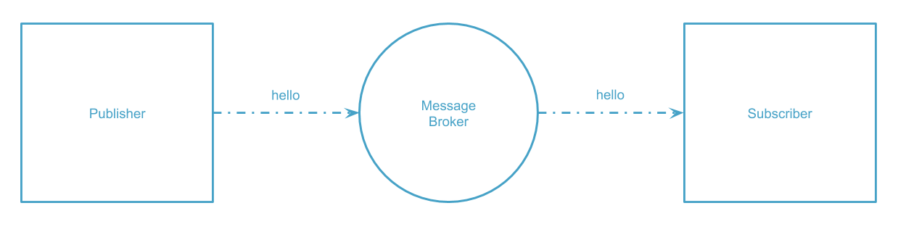

Slide 14
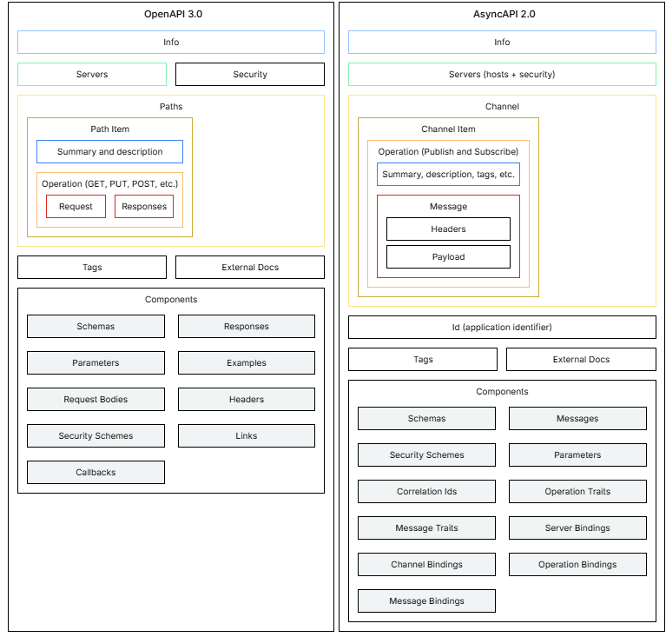

Slide 15

Creating schemas and channels using AsyncAPI theory and examples
Schema modeling with AsyncAPI components
Define reusable components for payloads, parameters, and headers, then reference them consistently from operations to reduce drift.
Validation driven development with Pydantic models
Use Pydantic to enforce types, constraints, and parsing rules that mirror your AsyncAPI message schemas for end to end safety.
Channel organization and operation structure
Structure channels with publish/subscribe roles and document message flow, leveraging the tutorial walkthrough to avoid common pitfalls.

Slide 16
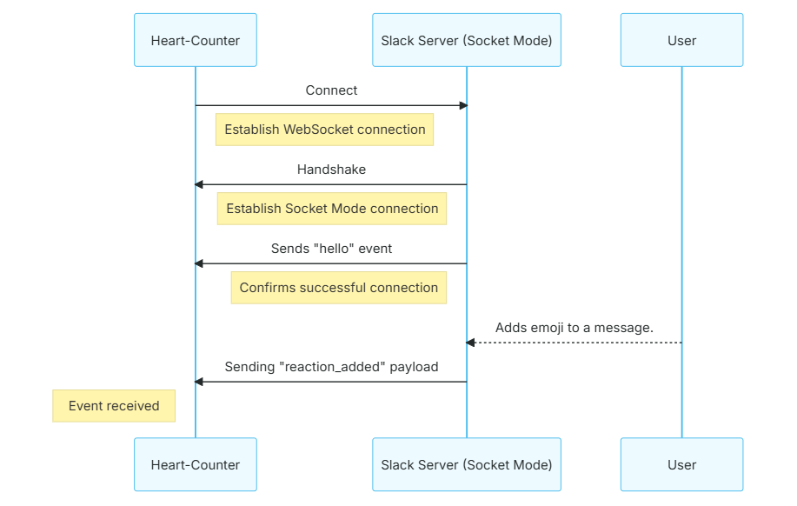
Notes:
https://www.asyncapi.com/docs/tutorials/websocket

Slide 17
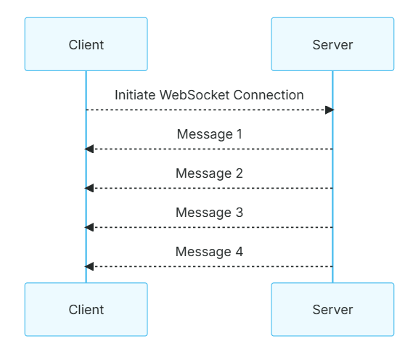

Slide 18
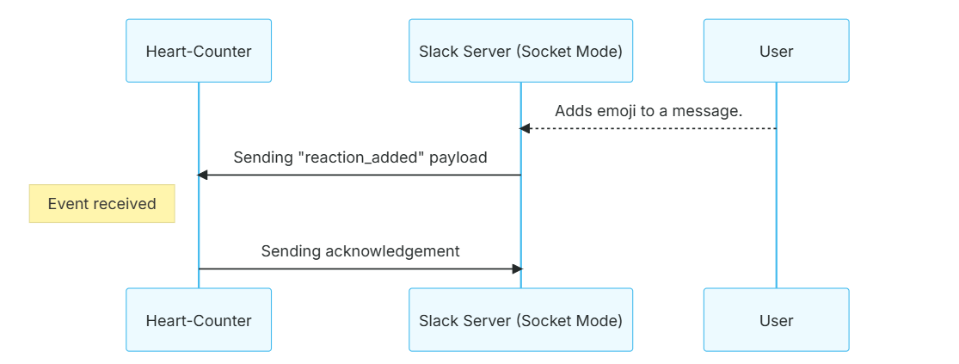
Notes:
https://www.asyncapi.com/docs/tutorials/websocket/websocket-request-reply

Slide 19
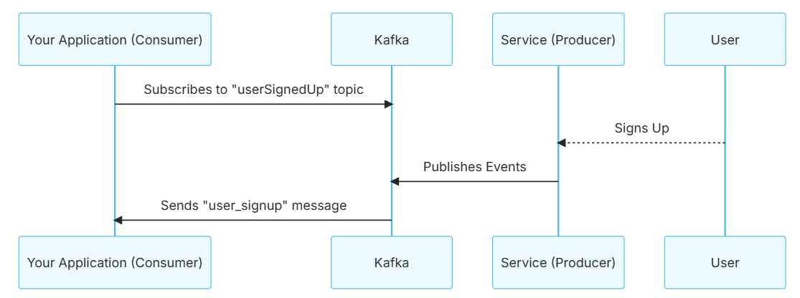
Notes:
https://www.asyncapi.com/docs/tutorials/kafka

Slide 20
Validating and iterating using AsyncAPI Studio lab exercises
1
Building schemas from real payload examples
Iterate on models using documented techniques from the complete Pydantic guide, improving reliability before integration with services.
2
FastAPI endpoints that serve validated event data
Create HTTP routes with FastAPI first steps, using path parameters and request bodies that are validated by Pydantic models.
3
Deep validation with Pydantic get started guides
Apply Pydantic validation features like field constraints and error reporting to ensure incoming event payloads match expected contracts.

Slide 21
Pydantic validation for robust Python data models

Slide 22

Defining types and validators for clean data integrity
AsyncAPI modeling for event payloads
Use the tutorial to define channels, operations, and message schemas for event-driven APIs with clear contracts and examples.

Slide 23

Applying Pydantic model configuration and field constraints
Field constraints for safer schema evolution
From the DataCamp and guide resources, add constraints like ranges, lengths, and patterns to reduce downstream error handling.
Pydantic configuration for robust models
Use the get-started documentation to configure validation behavior, defaults, and strictness for reliable data integrity across services.
FastAPI schema generation with constraints
Leverage editor-driven FastAPI workflows to ensure OpenAPI reflects Pydantic constraints for accurate client integration and testing.
AsyncAPI schema alignment with validation
Create AsyncAPI documents whose message schemas mirror Pydantic validation rules to keep contracts consistent across event and HTTP layers.

Slide 24


Using editor workflows to speed up FastAPI compatible schemas
Studio lab for AsyncAPI document authoring
VS Code guidance for FastAPI development
Practice in AsyncAPI Studio to generate a working spec quickly, then iteratively refine channels and message definitions.
Use the VS Code FastAPI tutorial to streamline coding, linting, and schema-first development with Pydantic-backed endpoints.

Slide 25
3 FastAPI endpoints and LLM SDK usage for applications

Slide 26
Building path operations in FastAPI with dependable request handling
Path parameter validation with typed function signatures
Define path parameters with Python types so FastAPI performs automatic parsing and validation, reducing manual checks and preventing malformed requests from reaching business logic.
FastAPI routing patterns for robust endpoints
Use FastAPI path syntax to design clear, versionable routes, validate parameters early, and keep handler logic deterministic for consistent behavior across async workloads.
VS Code guided setup for FastAPI development
Follow the editor-based tutorial to structure a minimal FastAPI project, configure run/debug workflows, and verify responses end to end while iterating quickly.
Beginner-friendly FastAPI implementation roadmap
Leverage the beginner tutorial to connect routing, request handling, and response generation, then extend the same patterns for production-grade async services.

Slide 27
Connecting validated Pydantic models to FastAPI request and response
VS Code example workflows for Pydantic integration
Implement the complete Pydantic guide’s patterns in a local environment, using saved examples to wire models into FastAPI handlers efficiently.
DataCamp learning path for practical Pydantic skills
Use the tutorial to learn core concepts with guided exercises, then translate those lessons into reusable model patterns for API inputs and outputs.
Pydantic model design for reliable data contracts
Model request and response payloads with Pydantic types, ensuring strict schemas, predictable field behavior, and clear error reporting for clients consuming the API.

Slide 28
Integrating OpenRouter client SDKs for LLM powered features
Designing async LLM features with event-driven APIs
Combine event-driven design with LLM calls by triggering workflows via messages, allowing scalable processing without blocking HTTP request threads.
AsyncAPI document creation for system interoperability
Use the AsyncAPI tutorial to draft a complete event specification, including channels, payload schemas, and example messages for LLM-related events.
AsyncAPI Studio lab for validating message contracts
Open AsyncAPI Studio to simulate and review your specification, ensuring producers and consumers agree on payload shapes and operation semantics.

Slide 29

Thank You

